Slide 1

Airlines Delay
BY VISION TEAM

Slide 2
TEAM MEMBERS
NAWAF ALOMAIR
OHOOD ALSOHAIME
NOOF ALSAF
MARINE ALRAQDI
MANAR ALJAZAERI
HASSAN ALMAGHRBI

Slide 3
TABLE OF CONTENTS
01
03
02
Introduction
About Dataset
Data Cleaning
04
05
06
Dashboard
Answering 10 Questions using Pig Latin
Conclusion

Slide 4
01
Introduction

Slide 5
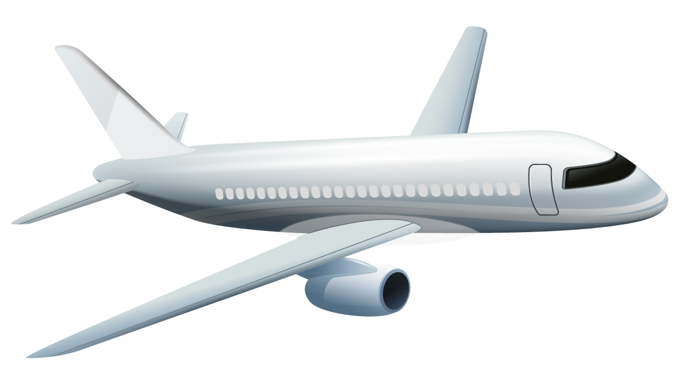
INTRODUCTION
Apache Pig is a high-level platform for creating programs that run on Apache Hadoop. The language for this platform is called Pig Latin.
Pig is a high-level platform or tool which is used to process the large datasets. It provides a high-level of abstraction for processing over the MapReduce.

Slide 6
02
About Dataset

Slide 7
Dataset Information
About
Columns
Features
The data consists of flight arrival and departure details for all commercial flights within the USA, from Jan to Dec 2008.
29 columns
1936758 Records in total

Slide 8
Columns Details
Year
2008
Month
1-12
DayofMonth
1-31
DayOfWeek
1 (Monday) - 7 (Sunday)
DepTime
Actual departure time
CRSDepTime
Scheduled departure time
ArrTime
Actual arrival time
CRSArrTime
Scheduled arrival time
UniqueCarrier
Unique carrier code
FlightNum
Flight number
TailNum
plane tail number: aircraft registration unique aircraft identifier

Slide 9
Columns Details
ActualElapsedTime
In minutes
CRSElapsedTime
Computerized Reservations Systems (CRS)In minutes
AirTime
In minutes
ArrDelay
Arrival delay, in minutes
DepDelay
Departure delay, in minutes
Origin
Origin International Air Transport Association (IATA) airport code
Dest
Destination (IATA) airport code
Distance
In miles
TaxiIn
Taxi in time, in minutes
TaxiOut
Taxi out time in minutes

Slide 10
Columns Details
Cancelled
was the flight cancelled
CancellationCode
Reason for cancellation
Diverted
1 = yes, 0 = no
CarrierDelay
In minutes: Carrier delay is within the control of the air carrier.
WeatherDelay
In minutes: Weather delay is caused by extreme or hazardous weather conditions
NASDelay
in minutes: Delay that is within the control of the National Airspace System (NAS)
SecurityDelay
In minutes: Security delay is caused by evacuation of a terminal or concourse,
LateAircraftDelay
in minutes: Arrival delay at an airport due to the late arrival of the same aircraft at a previous airport.

Slide 11
03
Data Cleaning

Slide 12
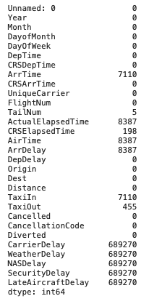


Null Values
To handle null Values
First, We Select numeric columns from the dataset
Then, we use mean to fill the null values

Slide 13
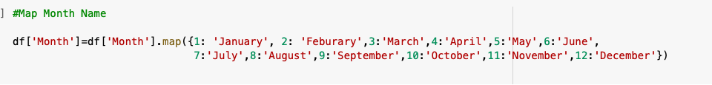
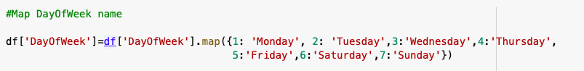
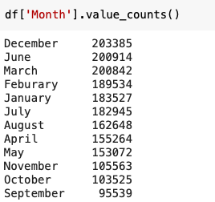
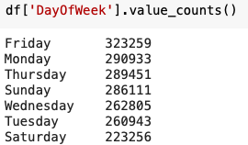
Change number of columns DayofMonth and Month to Name

Slide 14
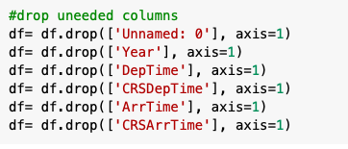
Drop unwanted Columns

Slide 15
Final Form of dataset

Slide 16
04
Dashboard
A graphical report of various data relevant to tells a story through visualizations.

Slide 17
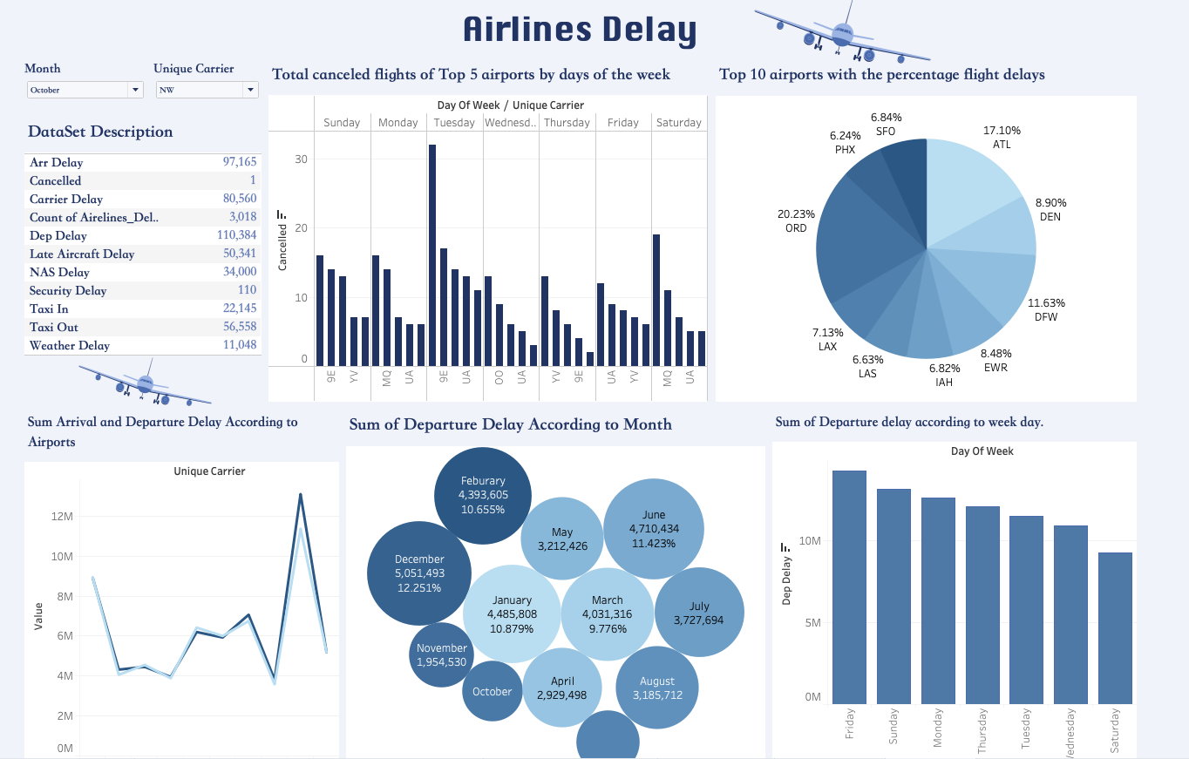
Dashboard

Slide 18
05
Answering 10 Questions using Pig Latin

Slide 19

Load Dataset

Slide 20
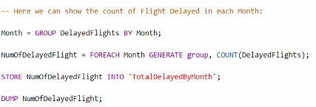

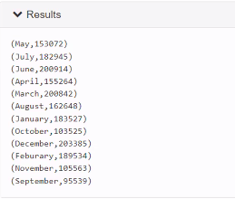
1. How many delayed flights per month?

Slide 21
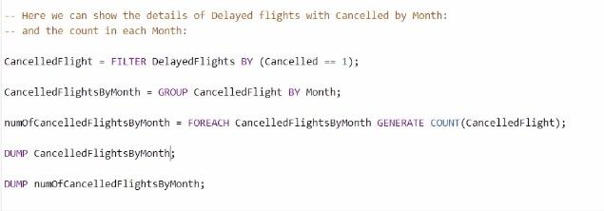
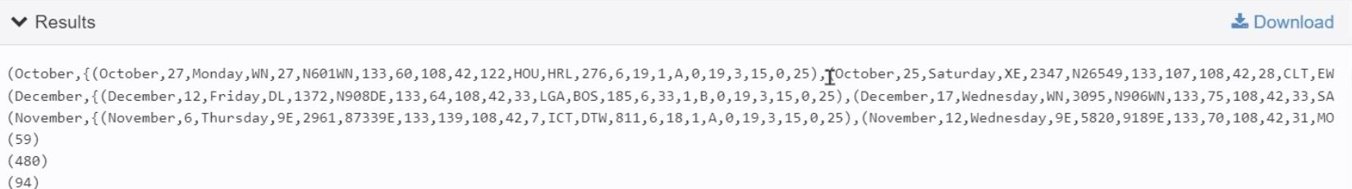
2. How many cancelled flights after delayed and its details for each month?

Slide 22
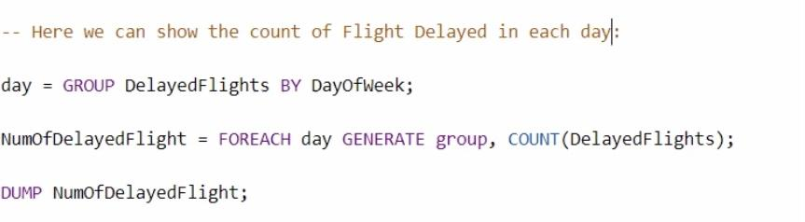
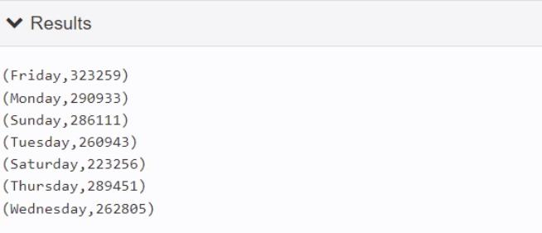
3. How many delayed flights per day?

Slide 23
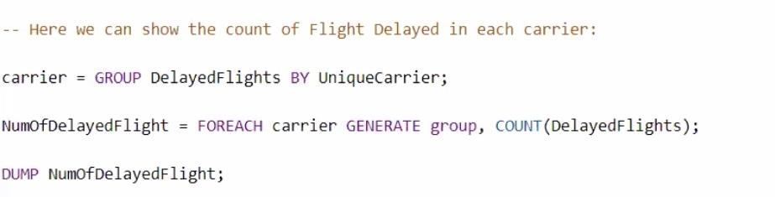
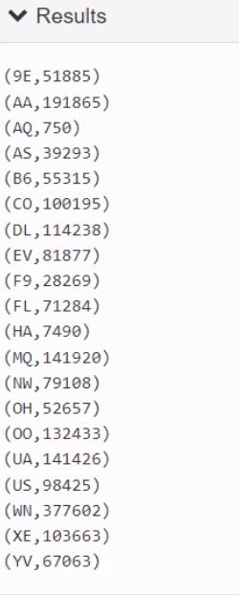
4. How many delayed flights for each airline??

Slide 24
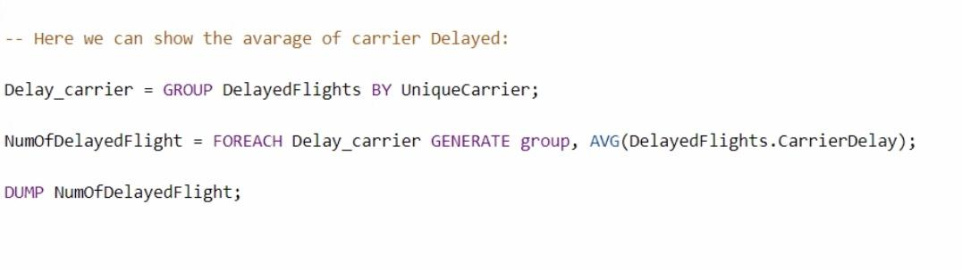
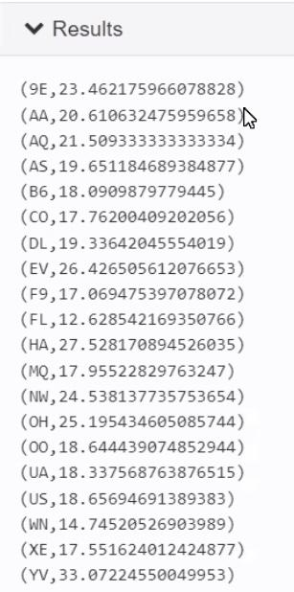
5. Average delays in minutes for each carrier?

Slide 25
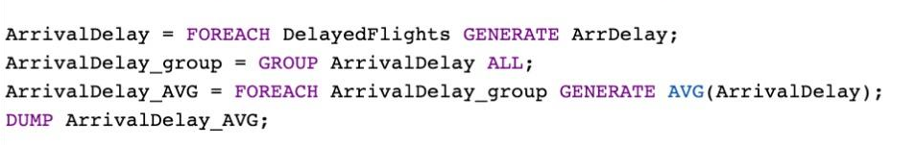
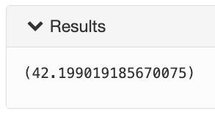
6. What is the Average of arrival delay

Slide 26
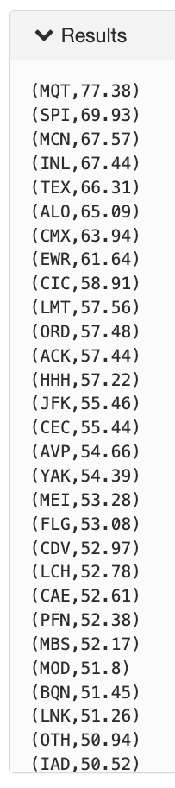
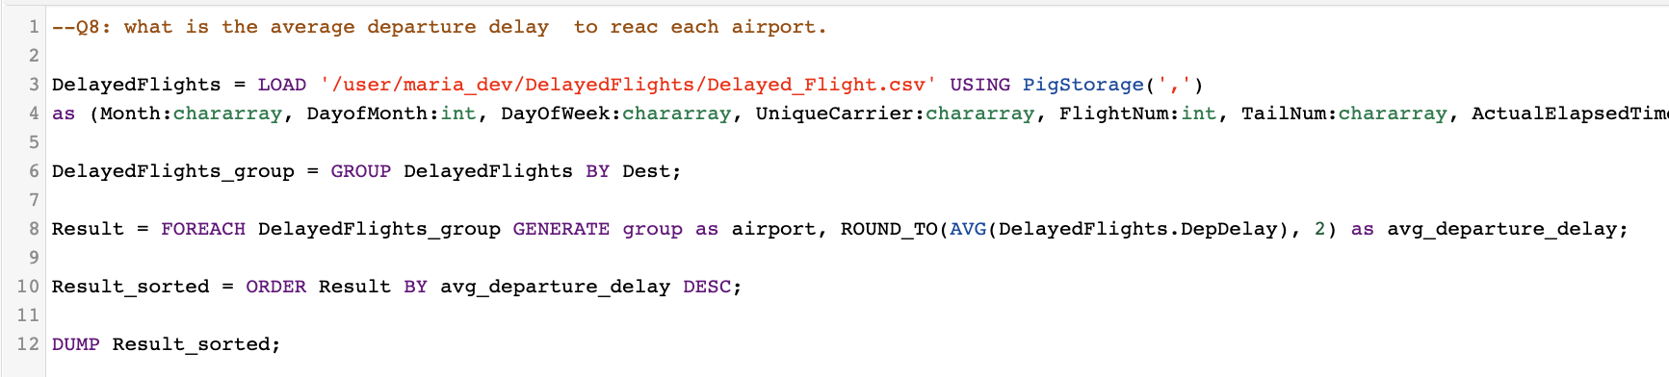
7. Average departure Delay for each Airport

Slide 27
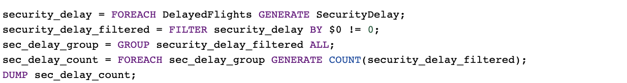
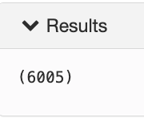
8. How many security delay in the year 2008

Slide 28
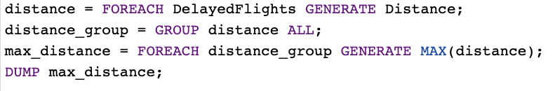
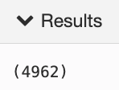
9.what is the maximum flight distance?

Slide 29
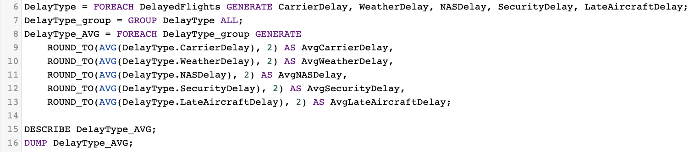
10.Average delay minutes for each delay type

Slide 30
Conclusion
As we know that aviation is an important thing, and many businesses can be delayed due to delayed flights, and it is also the fastest way to connect the parts of the world together. So, in the business world, the reputation of airlines can affect either positively or negatively to the companies contracting with them, or for the companies that book for their employees from there. Therefore, studying the causes of flight delays is important at the level of individuals or companies.

Slide 31
Thanks! Any Question?

